Slide 1

Hands-On Git
Health Sciences Library System
December 10, 2019
Helenmary Sheridan, Data Services Librarian
helenmary@pitt.edu

Slide 2

Schedule for today’s workshop
Lecture/discussion
Definitions
Use cases and open science
Git vs. Github
Hands-on tutorial pt. 1
BREAK
Hands-on tutorial pt. 2
Pair exercise: cloning, merging, and resolving conflicts
Lecture/discussion
Setting up a workflow that works
Choosing a hosting service
Integrations with other software
Using git for other things
Repository organization: READMEs, cookie cutter templates, licenses, and citations

Slide 3
Materials for today’s workshop
Handout and slides: https://github.com/helenmary?tab=repositories
Software Carpentry “Version Control with Git” lesson: https://swcarpentry.github.io/git-novice/
Basic UNIX commands: http://mally.stanford.edu/~sr/computing/basic-unix.html
Git glossary: https://git-scm.com/docs/gitglossary

Slide 4
Version control: “a system that records changes to a file or set of files over time so that you can recall specific versions later.” (Chacon and Straub, Pro Git Book 2nd edition (Apress, 2014))

Slide 5
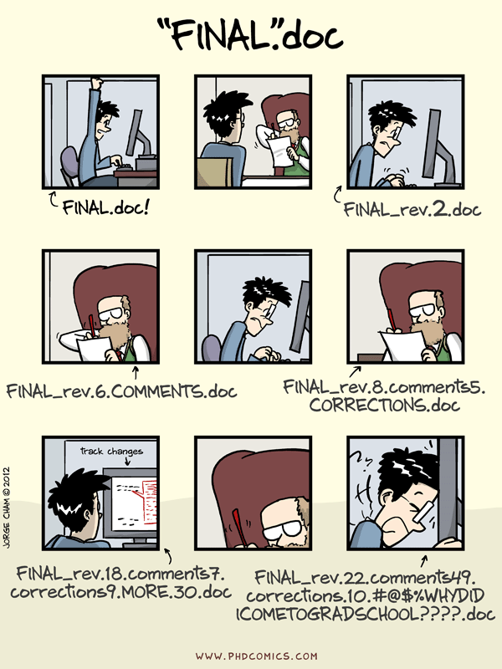
Ineffective version control in action
Piled Higher and Deeper, webcomic by Jorge Cham: http://www.phdcomics.com

Slide 6
Version Control Systems and Tools: An Incomplete List
Software
Git
Github
Bitbucket
SVC
Files (documents and data)
Google Docs
Box Notes
Git
Github
Microsoft Word (kind of)
Not the same!
File systems
Google Drive
Dropbox
Box
Git
Github

Slide 7
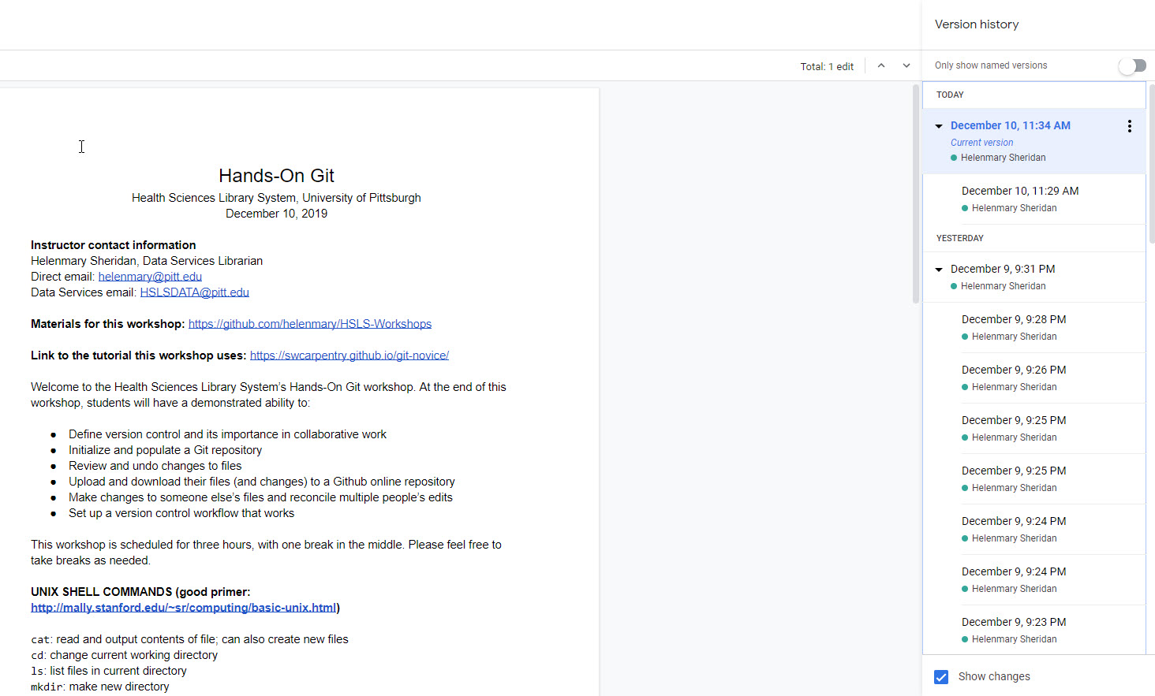
Versioning in Google Docs

Slide 8

Models of version control
Side-by-side versioning
Tree-with-merges versioning
V1
V2
V2_Karen’s edits
V2_Karen’s edits
V3
V1
V2
V3

Slide 9
Version control is not the same thing as backup.
Version control is not the same thing as backup!

Slide 10

Limitations of Version Control
Version control can’t always save you from disaster!
If it’s a local system like Git, are data backed up somewhere?
If you’re using a collaborative system like Box or Google Drive, are account permissions in order?
Is everyone actually using it?

Slide 11
Materials for today’s workshop
Handout and slides: https://github.com/helenmary?tab=repositories
Software Carpentry “Version Control with Git” lesson: https://swcarpentry.github.io/git-novice/
Basic UNIX commands: http://mally.stanford.edu/~sr/computing/basic-unix.html
Git glossary: https://git-scm.com/docs/gitglossary

